Slide 1
Cymraeg Campus
Cymraeg Campus is a charter which consists of three awards; Bronze, Silver and Gold. Each award has ten targets to work towards; Target 1 – Establishing a Welsh ethos. Target 2 – The advantages of learning Welsh.
Target 3 - The use of incidental Welsh in the classroom.
Target 4 – The use of incidental Welsh outside of the classroom.
Target 5 – Welsh in assemblies.
Target 6 – Apps and Websites to enhance learning and enjoyment.
Target 7 – Enrichment activities.
Target 8 – Developing reading.
Target 9 – Welsh across the Curriculum.
Target 10 - A positive attitude.

Slide 2
The main aim of the Charter is to stimulate a strong Welsh ethos and provide a range of enriching activities that encourage the children to enjoy learning Welsh. Children in all classes experience a wide range of activities across the curriculum and are exposed to the Welsh Language throughout the day both in the classroom and around the school. We successfully received the Bronze Award in October 2019 and we are now working towards the Silver Award.
The Criw Cymraeg is a group of children who were elected from Year 1 to Year 6, who meet regularly to discuss progress of Cymraeg Campus and have many responsibilities such as awarding tocynnau iaith, choosing phrase of the week, holding meetings, updating the weekly school newsletter, planning and preparing activities, etc.

Slide 3
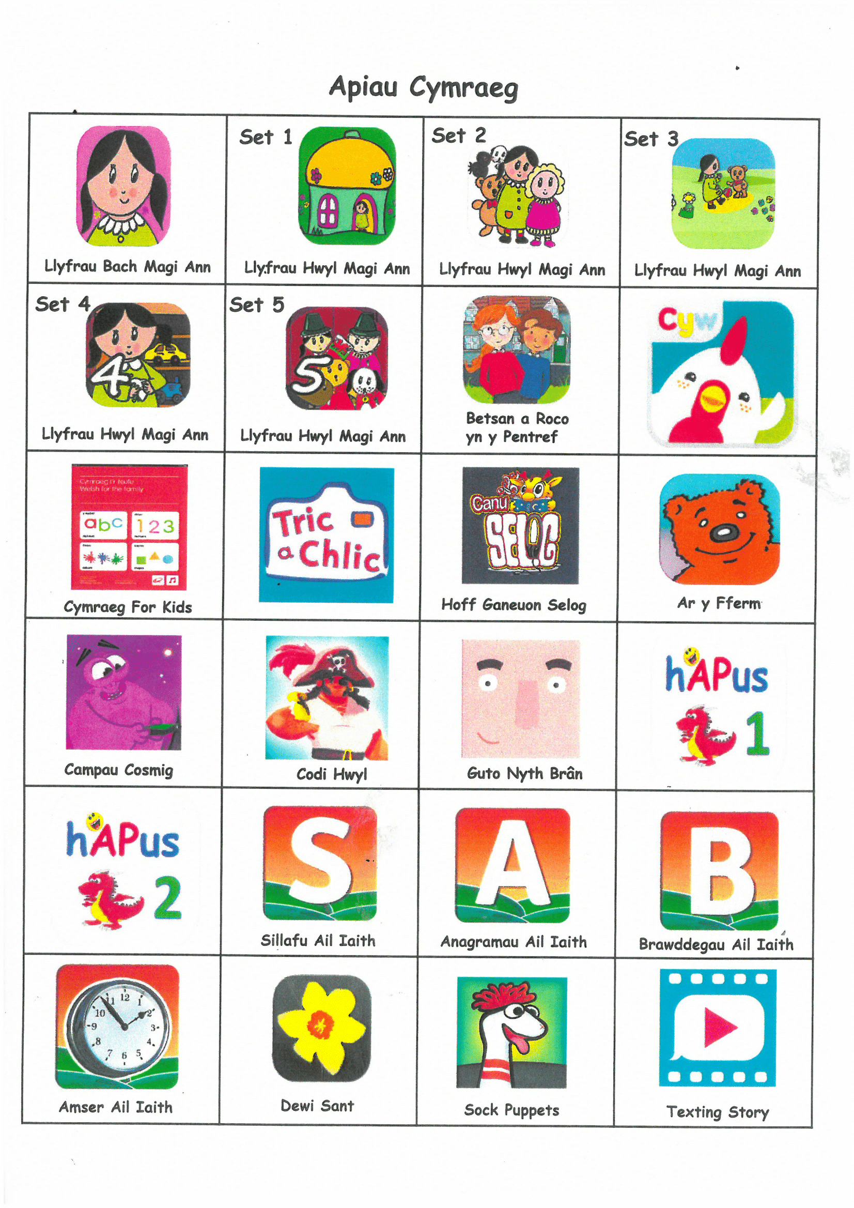
Apps that we use;

Slide 4
Websites that we use;
https://www.poridrwystori.org.uk/
http://www.s4c.cymru/cyw
https://libraries.wales/schools/
https://learnwelsh.cymru
https://www.learn-welsh.net
https://www.bbc.co.uk/wales/learning/learnwelsh
https://dinolingo.com/learn-welsh-for-kids

Slide 5
Here are some phrases we use at Ysgol Tŷ Ffynnon....
Eisteddwch – Sit
Sefwch – Stand
Ewch – Go
Dewch - Come
Bore da – Good morning
Prynhawn da – Good afternoon
Hwyl fawr - Goodbye
Mae hi'n amser...chwarae/cinio/mynd adref/tacluso
It's......... playtime/dinnertime/home time/tidy up time.
Pwy wyt ti? - Who are you?
Beth ydy dy enw di? - What is your name?
Sut wyt ti? - How are you?
Bendigedig – Fantastic.
Da iawn diolch – Very well thankyou.
Wedi blino – Tired.
Hapus – Happy.
Drist – Sad.

